Slide 1
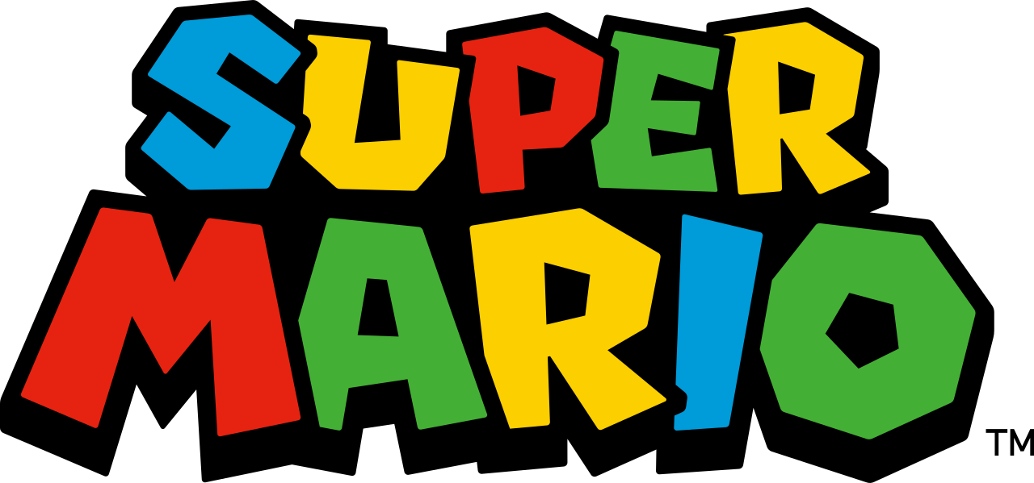
Super Mario

Slide 2
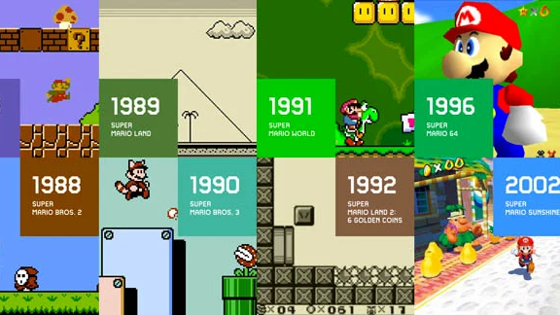
Super Mario Bros

Slide 3
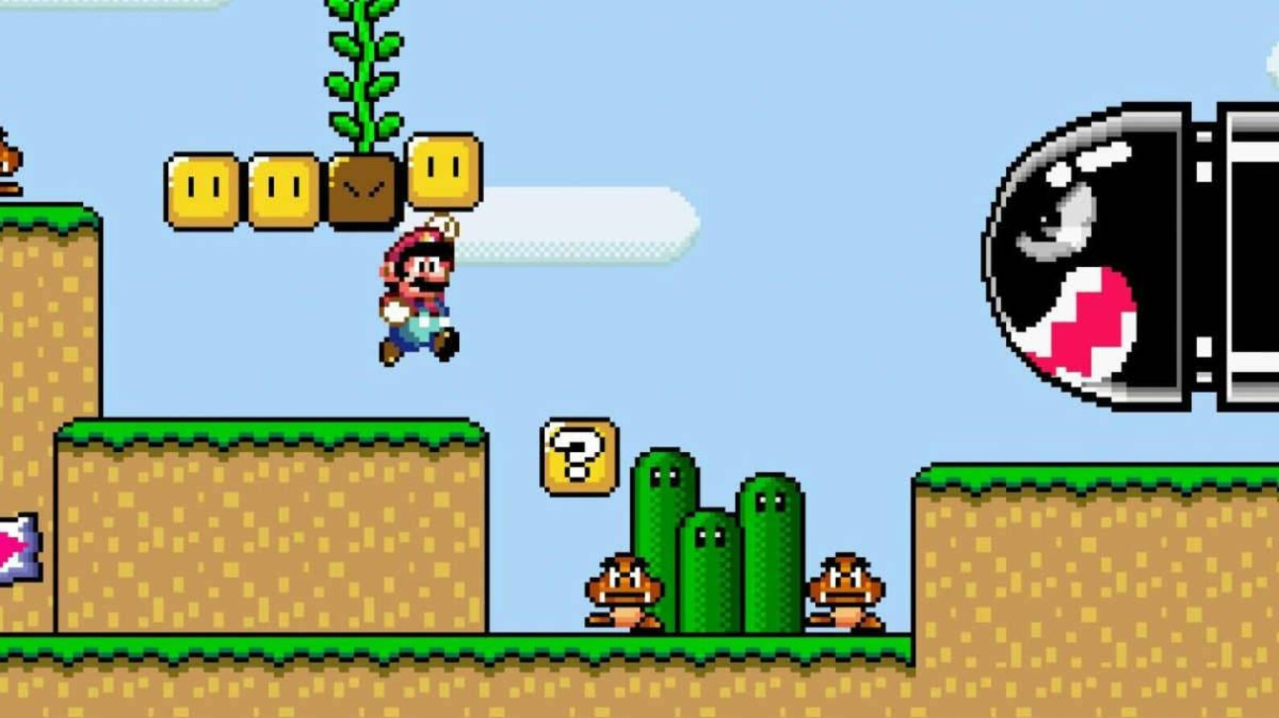
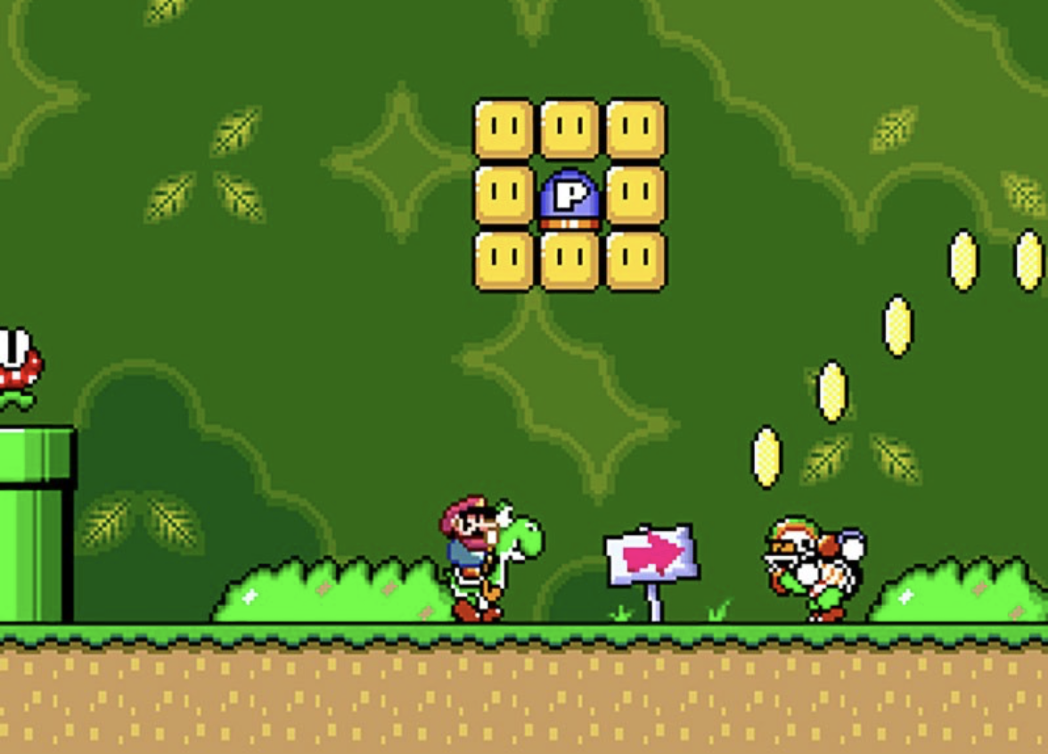
What makes Super Mario unique?

Slide 4
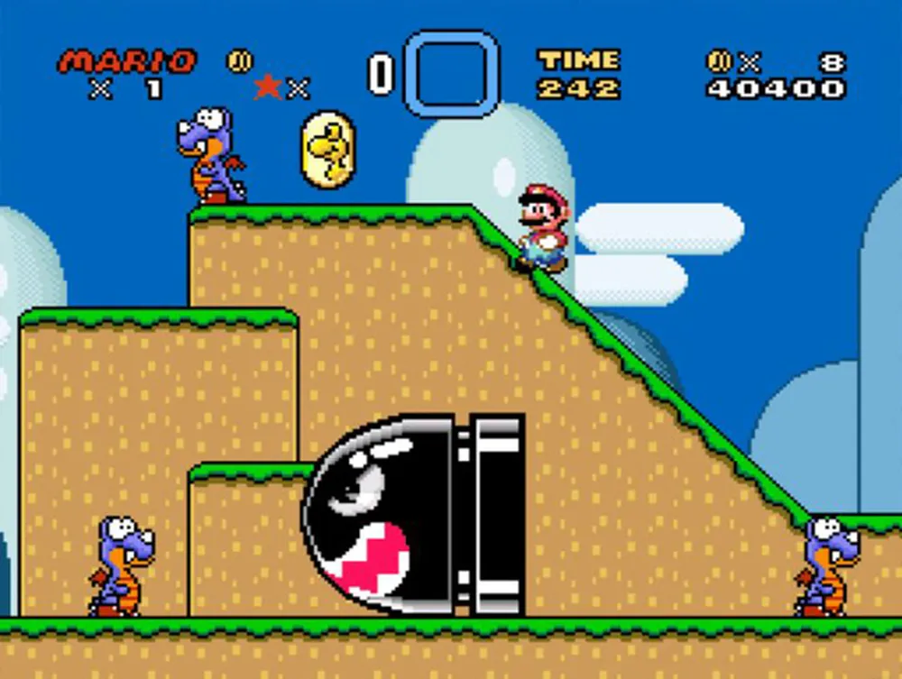
Key characteristics (requirements)
Side scroller: Mario/Camera moves right
Ground tiles + levels to climb up
Gravity effect of jump/double jump
Collects coins and optional powerups
Enemies (Goombas) try to take lives.
Time limit in which Mario must reach the end of the level
Notes:
https://protipoftheday.com/node/113.html

Slide 5
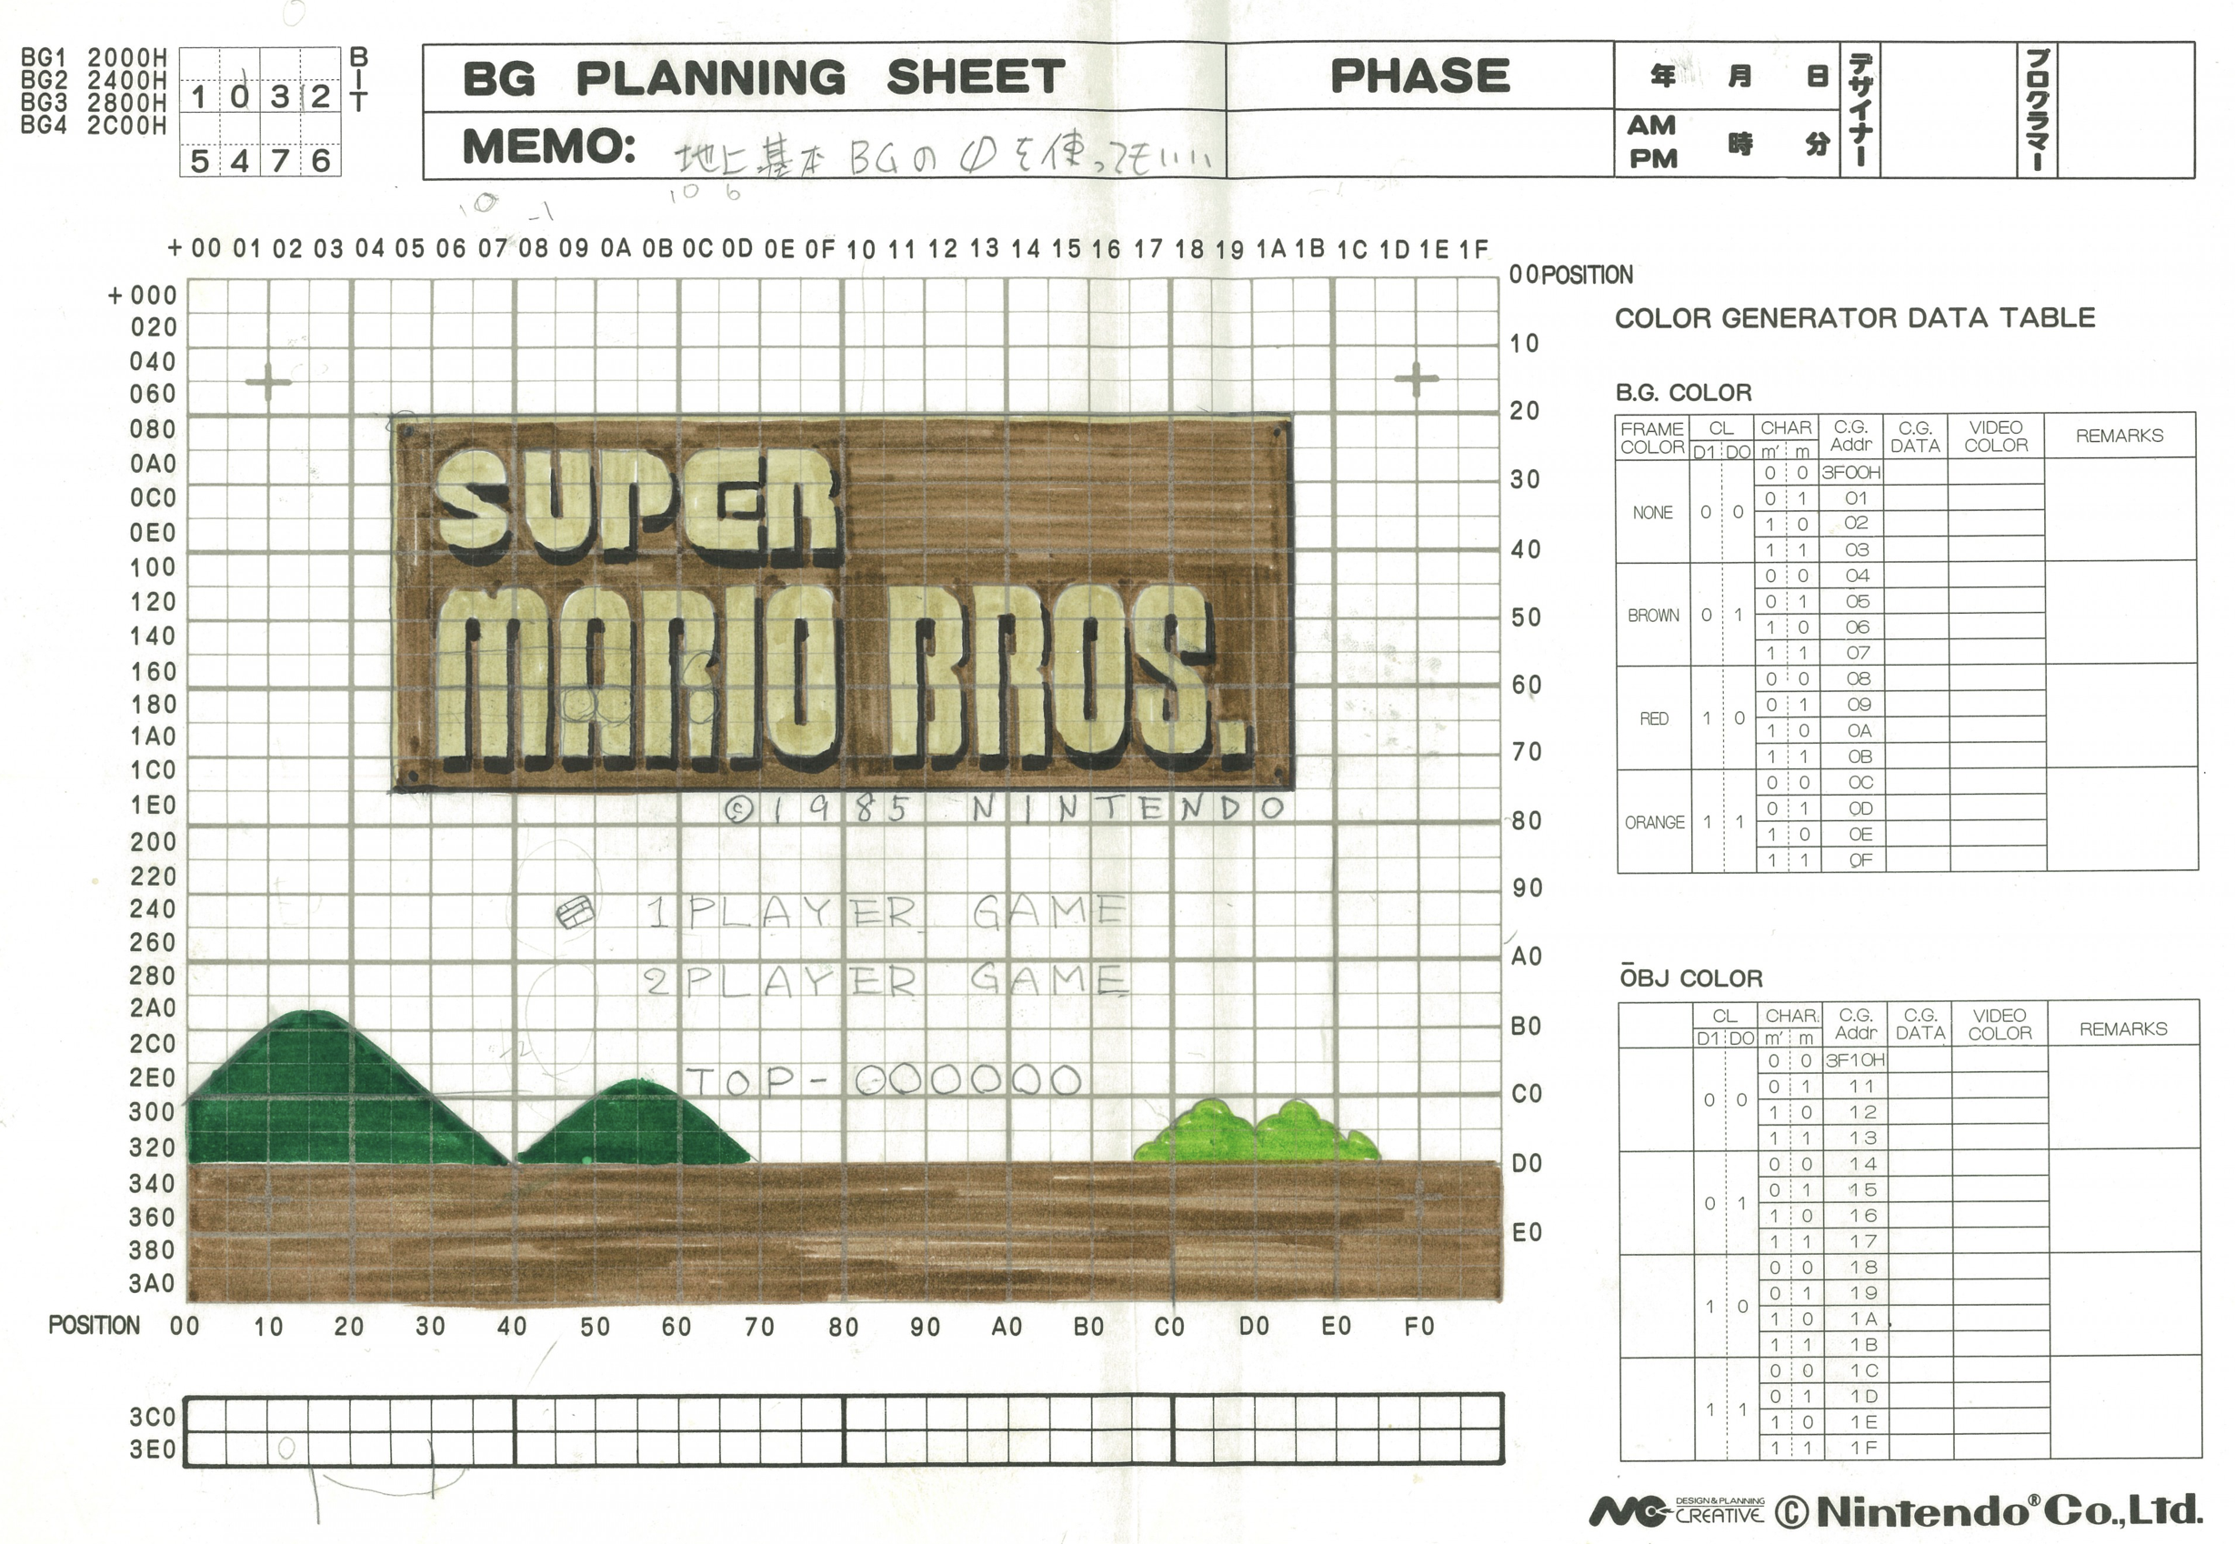
Paper design!

Slide 6
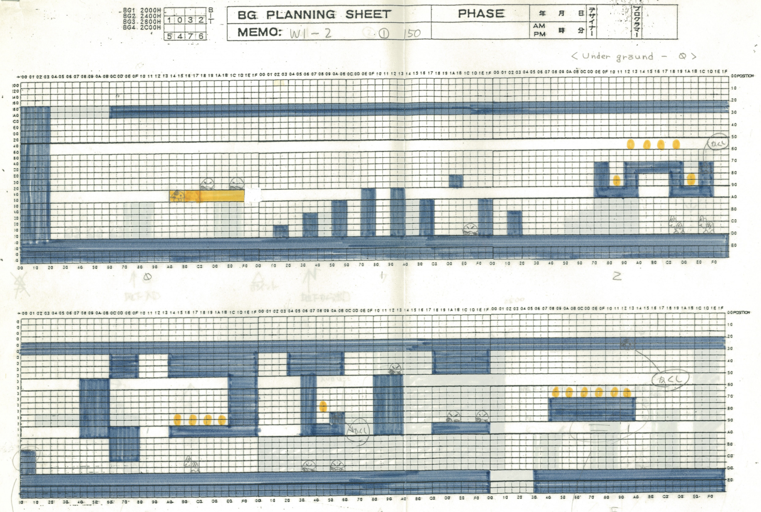
Paper design!

Slide 7
How do we design a solution to this?
Mario would move right (optionally left if levels allows)
Move coordinates (x) when respond to left and right key press
The array of blocks
2D array of graphics?
Moving camera with Mario
An x coordinate to keep a track of this?
Compare x/y coordinates?
Jump/double jump - gravity
Change the x and y coordinates accordingly

Slide 8
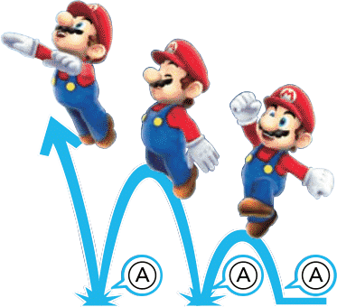
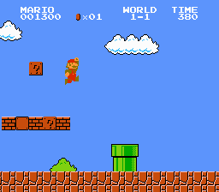
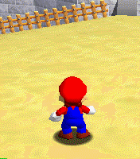
Double jump
Notes:
https://www.mariowiki.com/Double_Jump_(consecutive)

Slide 9
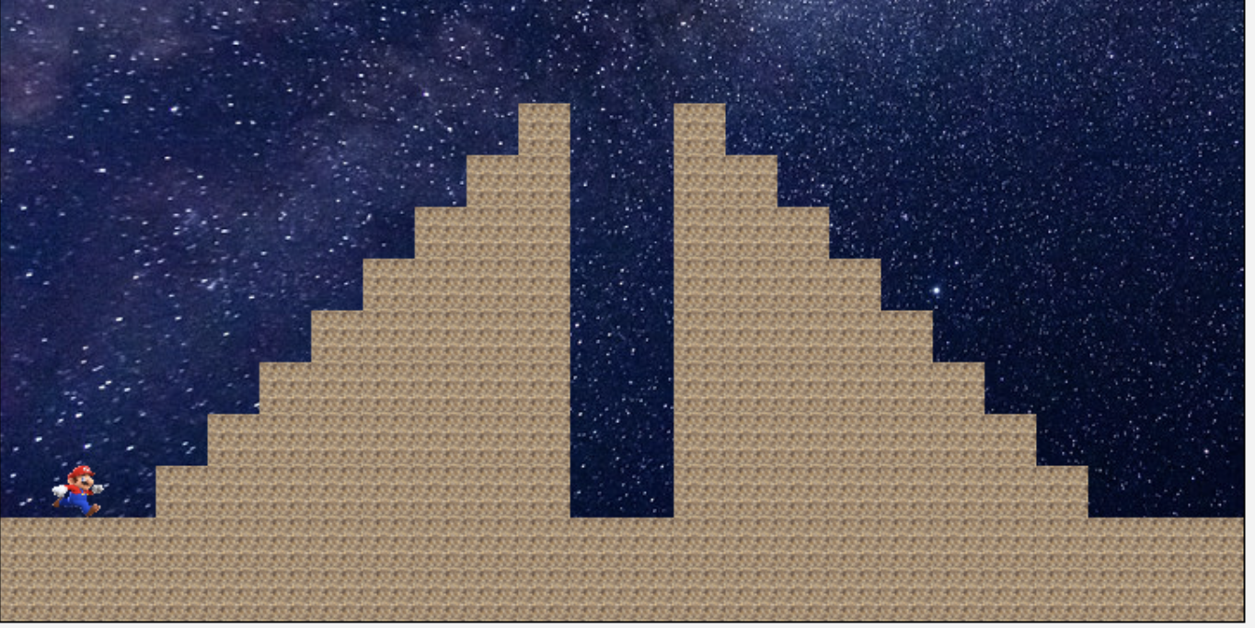
2D Array?

Slide 10
2D Array?
0 1 2 3
4 5
6
7

Slide 11
2D Array?
0 1 2 3 4 5 6 7 8 9 10 11 12 13 14 15 16 17
0 1 2 3
4 5
6
7

Slide 12
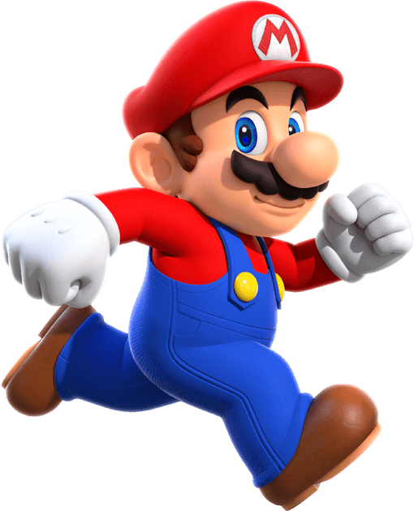

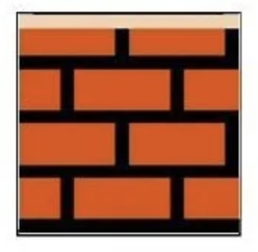
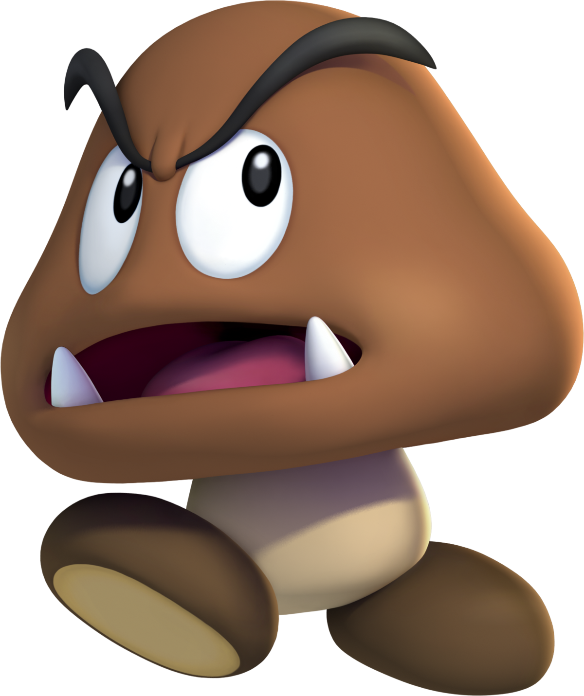
What about OOP?
Should we build some of these entities as classes?
Notes:
https://www.raspberrypi.com/news/coding-space-invaders-disintegrating-shields-wireframe-9/
https://spaceinvaders.fandom.com/wiki/UFO
https://opensea.io/assets/matic/0x2953399124f0cbb46d2cbacd8a89cf0599974963/44780268195173871161572035472768948089987869065093867251645780525528479957092

Slide 13
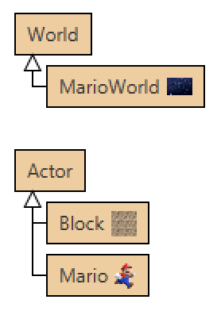
OOP in Greenfoot
Notes:
https://www.raspberrypi.com/news/coding-space-invaders-disintegrating-shields-wireframe-9/
https://spaceinvaders.fandom.com/wiki/UFO
https://opensea.io/assets/matic/0x2953399124f0cbb46d2cbacd8a89cf0599974963/44780268195173871161572035472768948089987869065093867251645780525528479957092

Slide 14
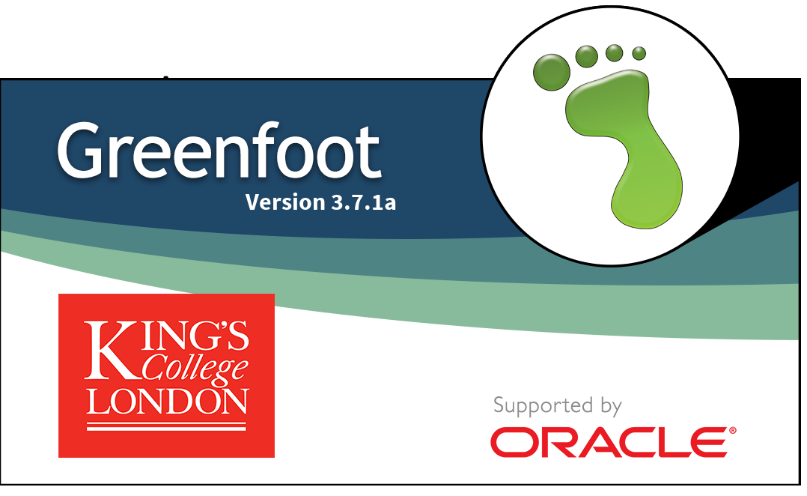
Implementation

Slide 15
Summary
Establish key requirements – what makes Mario unique?
THINK about how possible solutions (design) BEFORE coding
When you implement – build in stages – you could focus on building and testing one requirement/key feature at a time.

